Slide 1
Introduction to O.O.P

Slide 2

Data

Slide 3
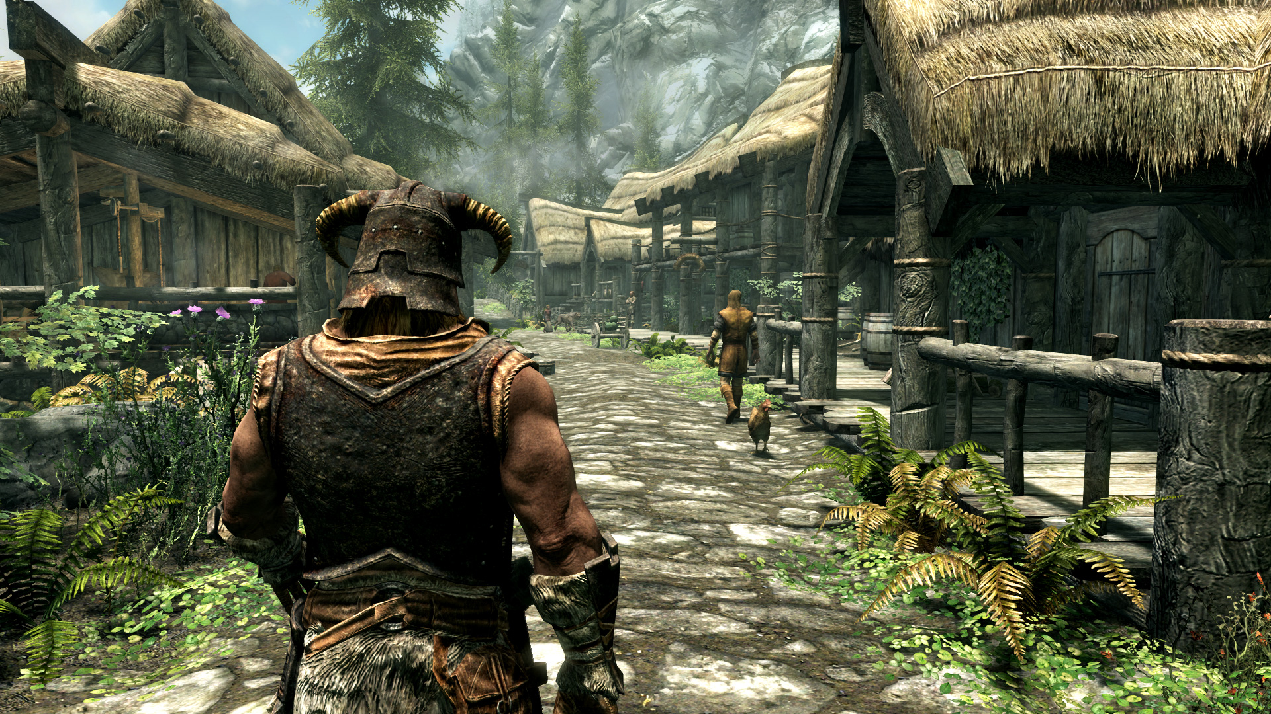
Data
RPG Player Data
Name (String)
Health (Float)
Mana (Float)
Stamina (Float)
Items (String[])

Slide 4
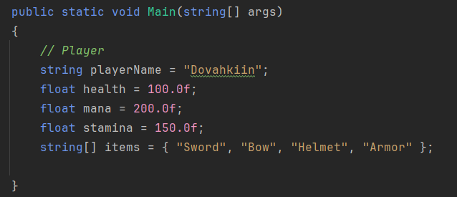
Data
RPG Player Data
Name (String)
Health (Float)
Mana (Float)
Stamina (Float)
Items (String[])

Slide 5
Data
RPG Player Data
Multiple data, all corresponding to the player.

Slide 6
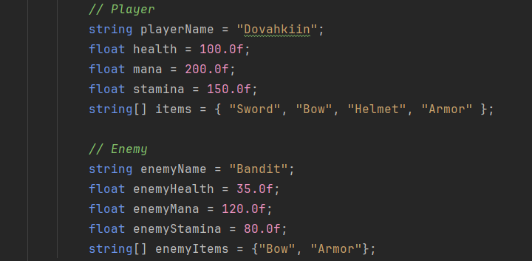
Data
RPG Player Data
What if we have an enemy, and this enemy also has the same data as the player?

Slide 7
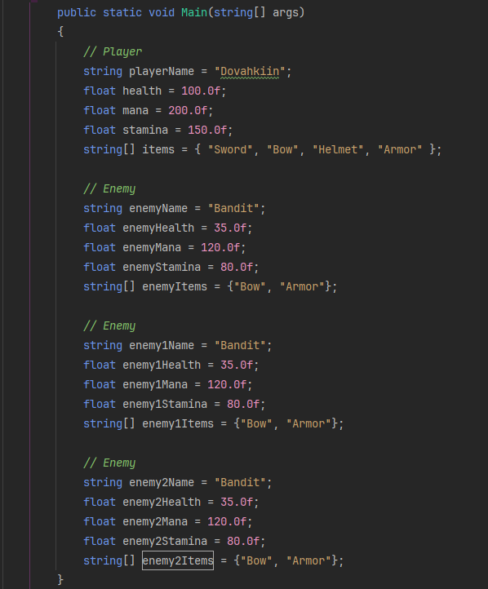
Data
RPG Player Data
How about multiple enemies.

Slide 8
Data
RPG Player Data
Pretty tedious.
Having to constantly create 5 new variables for each enemy in our game!

Slide 9
Data
RPG Player Data
They all have the same type of data, and they all handle it the same way.

Slide 10
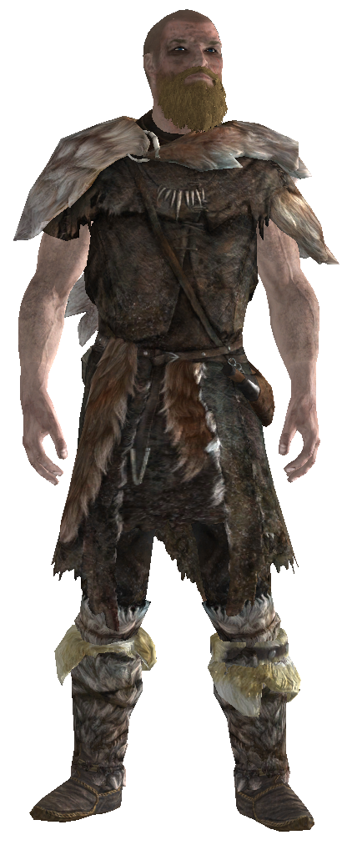
Data
RPG Player Data
Name: Dovahkiin
Hp: 100
Mp: 200
Sp: 150
Items: “Sword”,…
Name: Bandit
Hp: 35
Mp: 120
Sp: 80
Items: “Sword”,…
Name: Bandit
Hp: 35
Mp: 120
Sp: 80
Items: “Sword”,…
Name: Bandit
Hp: 35
Mp: 120
Sp: 80
Items: “Sword”,…
Name: Bandit
Hp: 35
Mp: 120
Sp: 80
Items: “Sword”,…

Slide 11
Data
RPG Player Data
Grouping Data

Slide 12

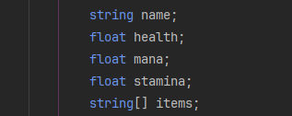
Grouping Data
RPG Player Data
Character
Name
Health
Mana
Stamina
Item

Slide 13
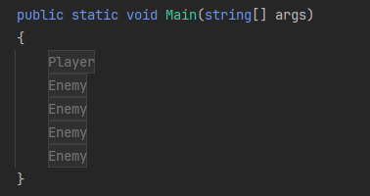
Grouping Data
RPG Player Data
Player
Enemy
Name
Health
Mana
Stamina
Item
Name
Health
Mana
Stamina
Item

Slide 14
Data
RPG Player Data
Class

Slide 15
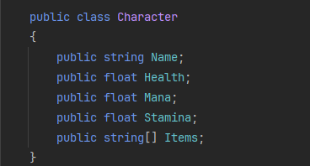
Class
RPG Player Data
A class is simply a user defined reference datatype.
Just like int[].
A class is a data container too.
It CONTAINS data.

Slide 16
Class
RPG Player Data
It’s a template for how the data is stored and structured.

Slide 17
Class
RPG Player Data
Class Definition

Slide 18
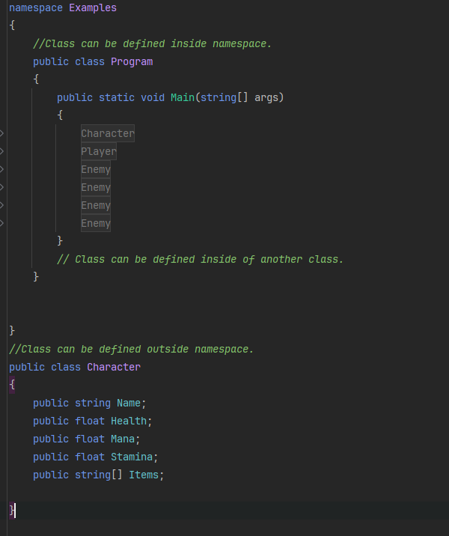
Class Definition
RPG Player Data
Class can be defined inside or outside a namespace.
It can also be defined inside another class (Like class Program)

Slide 19
Class Definition
RPG Player Data
Class definition is composed of 3 parts.

Slide 20
Class Definition
RPG Player Data
Class keyword

Slide 21
Class Definition
RPG Player Data
Access Modifier
Controls scope visibility.
(More on that later)

Slide 22
Class Definition
RPG Player Data
Class Name
Same name rules as variables and functions.

Slide 23
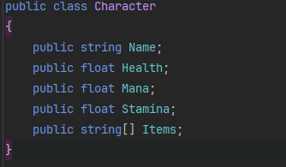
Class Definition
RPG Player Data
Any variable defined in the main scope/body of the class is called a member field.

Slide 24
Class Definition
RPG Player Data
Variables must also have an access modifier just like class.
For now we will only write public access modifier.

Slide 25
Class
RPG Player Data
Class Instantiation

Slide 26
Class Instantiation
RPG Player Data
Here Character is what’s known as a user defined type.
It’s a reference type similar to arrays.

Slide 27
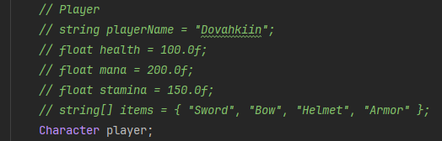
Class Instantiation
RPG Player Data
We can start creating variables of type character!
Variables of type of a class are called OBJECTS.

Slide 28
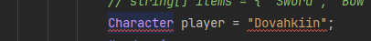
Class Instantiation
RPG Player Data
But, how do we use that new datatype?
We can’t just say
player = “Dovahkiin”

Slide 29
Class Instantiation
RPG Player Data
We first need to Instantiate the object.

Slide 30
Class Instantiation
RPG Player Data
Which is quite similar to arrays!

Slide 31
Class Instantiation
RPG Player Data
Notice the new keyword?
For now, anything that uses a new keyword will ALWAYS be a reference type.
(Except for something called a Struct, which we won’t talk about now but you could search it up if you would like!)

Slide 32
Class Instantiation
RPG Player Data
New keyword is followed by a “Function” called the constructor method.

Slide 33
Class Instantiation
RPG Player Data
Constructor method simply declares and initializes all fields.
It creates the key and the door needed.

Slide 34
Class Instantiation
RPG Player Data
Now this:

Slide 35
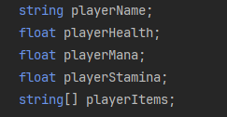
Class Instantiation
RPG Player Data
Is similar to this:

Slide 36
Class Instantiation
RPG Player Data
We have JUST declared the object and it’s data.
We haven’t YET initialized it.

Slide 37
Class Instantiation
RPG Player Data
But to initialize our data, we need to access them first.
So how can we access our data?

Slide 38
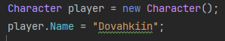
Class Instantiation
RPG Player Data
We use the dot operator.
You just write the name of the object followed by a dot and the name of the data you want to access.

Slide 39
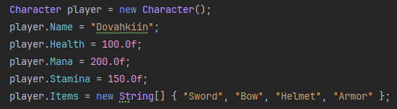
Class Instantiation
RPG Player Data
We can now populate our data:

Slide 40
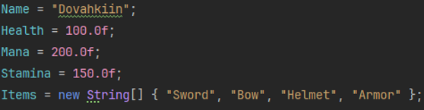
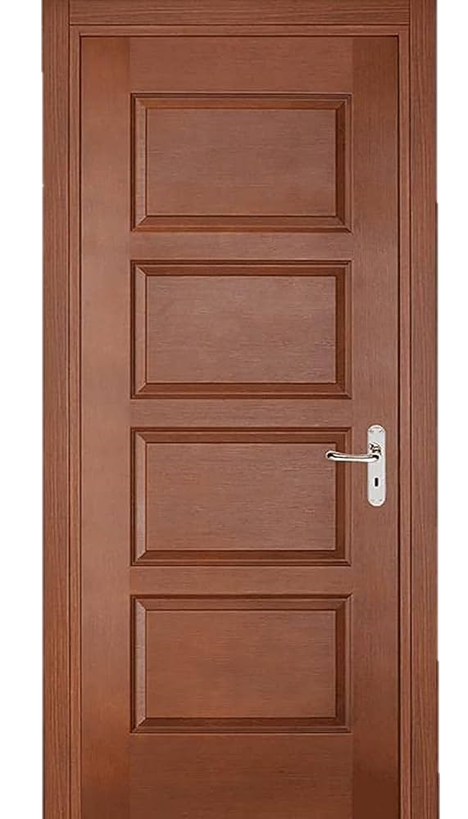

Class Instantiation
RPG Player Data

Slide 41
Class Instantiation
RPG Player Data
It’s still a lot of code to write and takes time to individually assign every field.

Slide 42
Class Instantiation
RPG Player Data
There must be a simpler way right?

Slide 43
Class Instantiation
RPG Player Data
There is! Instead of assigning each variable separately,
We will instead have a function do so for us!
It’s called the constructor function.

Slide 44
Class
RPG Player Data
Constructor

Slide 45
Constructor
RPG Player Data
Calling a constructor simply creates an object.

Slide 46
Constructor
RPG Player Data
But you might be wondering, where is the definition of this constructor? We haven’t defined it anywhere.

Slide 47
Constructor
RPG Player Data
This is called a Default Constructor.
The compiler ASSUMES that it exists.
It does absolutely nothing. It JUST creates the object.

Slide 48
Constructor
RPG Player Data
What if we want to add functionality to our constructor? Are we forced to only use this constructor?

Slide 49
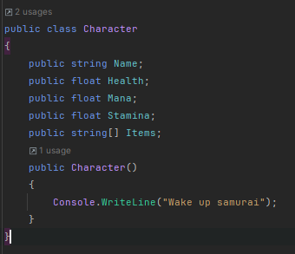
Constructor
RPG Player Data
Nope! You can just create your very own constructor and customize it.

Slide 50
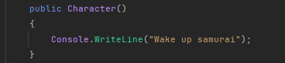
Constructor
RPG Player Data
Constructors have no return type. Like not even void, you literally don’t specify a return type.

Slide 51
Constructor
RPG Player Data
You also must specify an access modifier for them
(For now let’s just use public)

Slide 52
Constructor
RPG Player Data
THEY MUST BE THE SAME NAME AS THE CLASS!

Slide 53
Constructor
RPG Player Data
If your constructor is parameterless, it’s called a default constructor.

Slide 54
Constructor
RPG Player Data
Constructors are only called once per object.

Slide 55
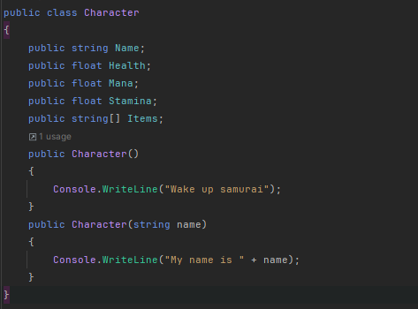
Constructor
RPG Player Data
We can also overload our constructors to take in any input!

Slide 56
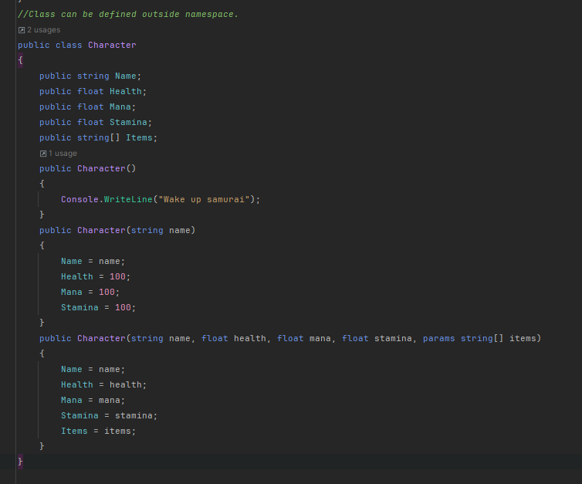
Constructor
RPG Player Data
We can assign our input to any one of our fields!
Remember, class is a scope, and any function inside the class (like constructor) is a smaller scope.
So we can access the variables of the class inside any of the functions of the class.

Slide 57
Constructor
RPG Player Data
Now when we create an object, we can pass in the values to the parameters into our overloaded constructor.

Slide 58
Constructor
RPG Player Data
We can still change any values to our liking.

Slide 59
Class
RPG Player Data
Methods

Slide 60
Methods
RPG Player Data
What if we want the player to damage a certain character?

Slide 61
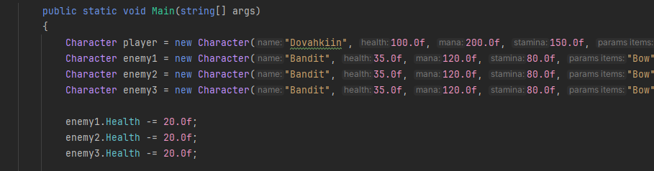
Methods
RPG Player Data
We can just subtract a certain amount of health from the enemies.

Slide 62
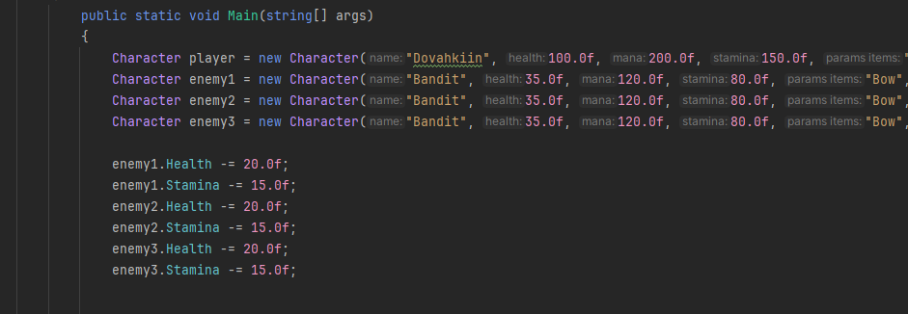
Methods
RPG Player Data
What if we want them to also lose some stamina when attacked?

Slide 63
Methods
RPG Player Data
Hmm this is getting complex, and we are also repeating code!

Slide 64
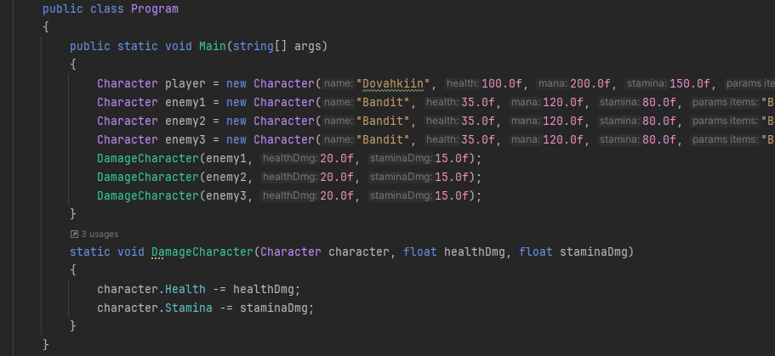
Methods
RPG Player Data
How about we instead create a function to damage them?

Slide 65
Methods
RPG Player Data
So far this is fine and works well for our purposes!

Slide 66
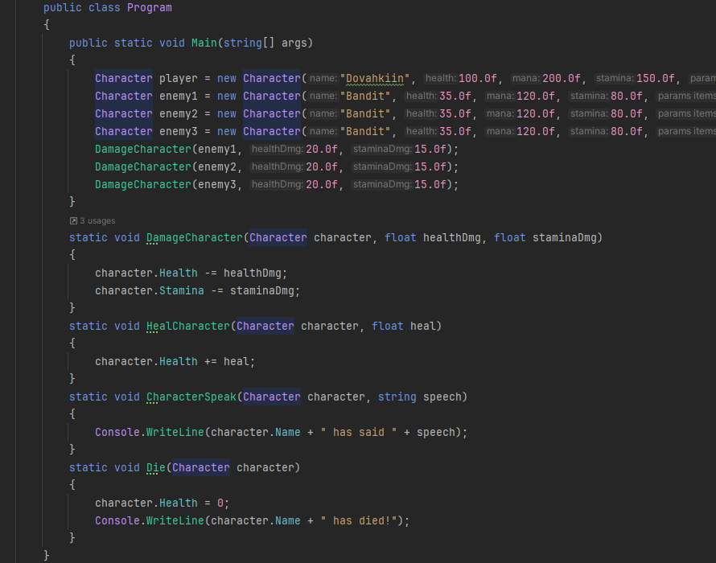
Methods
RPG Player Data
But suppose you had multiple functions you would like to implement.
Like Heal, Move, Speak, Die, etc…

Slide 67
Methods
RPG Player Data
Notice how we have to pass in a character in EVERY function?
This is repetitive…
We also have to specify that the function is for the character.
Which can be annoying.

Slide 68
Methods
RPG Player Data
First we have to identify WHAT we are trying to do.
We would like to represent a character as data.
Name
Health
Mana
Stamina
Items

Slide 69
Methods
RPG Player Data
This is quite similar to how things are defined in real life.
Everything got certain ATTRIBUTES/PROPERTIES (fields/variables)
And they also got certain BEHAVIOURS(methods/functions)
Name
Health
Mana
Stamina
Items

Slide 70
Methods
RPG Player Data
Some of the behaviours of our characters are:
Name
Health
Mana
Stamina
Items
Heal
TakeDamage
Speak
Die

Slide 71
Methods
RPG Player Data
In O.O.P, there is an important concept called Encapsulation.
Which suggests that every relevant data and function/method must exist inside of the relevant class.
Name
Health
Mana
Stamina
Items
Heal
TakeDamage
Speak
Die

Slide 72
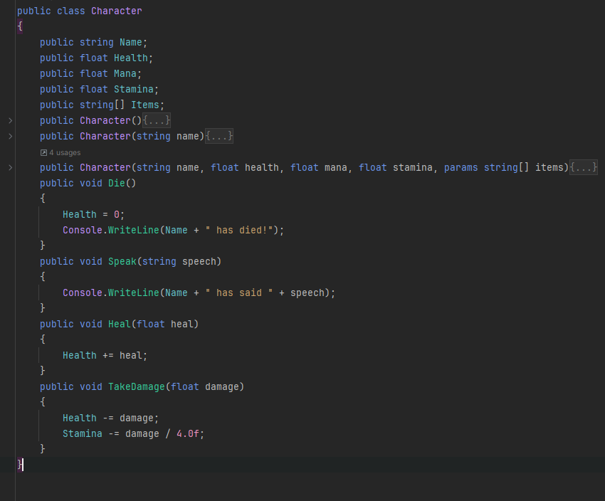
Methods
RPG Player Data
We can rewrite our functions inside of our class as methods.
This helps us achieve our concept of encapsulation!
Now all of the relevant data and methods are together in one place.

Slide 73
Methods
RPG Player Data
Methods are also called as member methods.

Slide 74
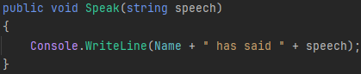
Methods
RPG Player Data
To define methods in your class,
You simply just specify an access modifier
(public)
before your function signature.

Slide 75
Methods
RPG Player Data
Notice how we didn’t write static here?
When you are defining member methods, you don’t specify that it’s static.
(We will know what static means later on)

Slide 76
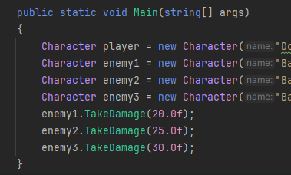
Methods
RPG Player Data
And we can access those member methods using the dot operator! Like such:

Slide 77
Methods
RPG Player Data
But how exactly does the method know WHICH name it should use here?

Slide 78
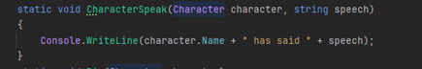
Methods
RPG Player Data
Here in this function we specified the object or the character instance of which we want to use the name of.

Slide 79
Methods
RPG Player Data
But here we are not specifying the instance.

Slide 80
Methods
RPG Player Data
Remember how we used the dot operator to access and call that method?
We are specifying the instance first THEN calling the method.

Slide 81
Methods
RPG Player Data
Which is exactly equivalent to this.
Just much cleaner and simpler.

Slide 82
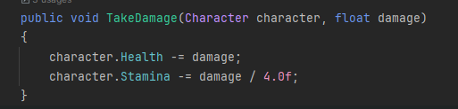
Methods
RPG Player Data
The method is basically working like this:

Slide 83
Methods
RPG Player Data
So when we call takedamage from the instance enemy1.
We are basically passing in enemy1 as the character.

Slide 84
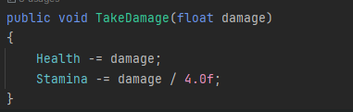
Methods
RPG Player Data
But in the actual method we never specified that a character is passed in?

Slide 85
Methods
RPG Player Data
This is because it’s done automatically.
EVERY member method in a class will always have a hidden parameter.
That parameter is the instance of the object.
Like enemy1.TakeDamage(20.0f);
Enemy1 is the hidden parameter.

Slide 86
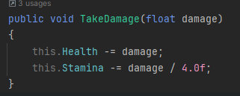
Methods
RPG Player Data
And this hidden parameter ALWAYS has the name
this

Slide 87
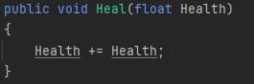
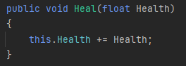
Methods
RPG Player Data
You can use this when you have parameters with the same name as a variable.
It let’s you specify which variable you are referencing.

Slide 88
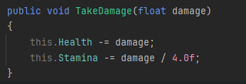
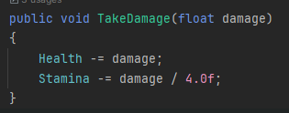
Methods
RPG Player Data
But other than that, whenever you access a field in a method, you implicitly use the this keyword.

Slide 89
Class
RPG Player Data
Access Modifiers

Slide 90
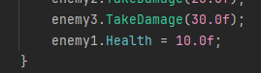
Access Modifiers
RPG Player Data
So far we have defined our characters data and functionalities.
But there is one CRUCIAL aspect we must consider.

Slide 91
Access Modifiers
RPG Player Data
Classes should be scopes, and scopes should limit the visibility of their own variables to it’s own scope only.
Here we can change the value of the health from anywhere.
This might result in unexpected behaviours and bugs.

Slide 92
Access Modifiers
RPG Player Data
Classes should be scopes, and scopes should limit the visibility of their own variables to it’s own scope only.
Here anyone can change the value of the health from anywhere.
This might result in unexpected behaviours and bugs.

Slide 93
Access Modifiers
RPG Player Data
How to get back the benefit of the scopes when using classes??

Slide 94
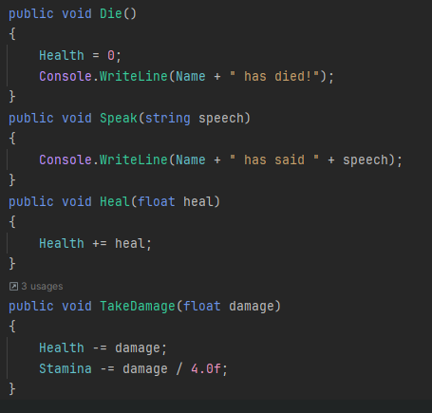
Access Modifiers
RPG Player Data
Our methods already deal with the data for us.
If we want to heal, we should just call the heal method.
If we took damage, we should just call the take damage method.
Our methods manipulate our data using our OWN logic and rules.

Slide 95
Access Modifiers
RPG Player Data
When you let others manipulate your data from outside of your class, you are invalidating the concept of Encapsulation.
They would manipulate the data using incorrect rules and logic.
Your data is NO LONGER encapsulated/safe.

Slide 96
Access Modifiers
RPG Player Data
What we learned so far is:
Methods should be the only thing that we can use to manipulate data.
Data should be hidden and inaccessible.

Slide 97
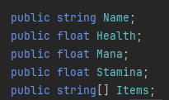
Access Modifiers
RPG Player Data
Remember when we defined our variables using an access modifier that we called public?

Slide 98
Access Modifiers
RPG Player Data
Public access modifier means that ANY one can access our data.
THAT’S NOT WHAT WE WANT!

Slide 99
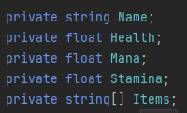
Access Modifiers
RPG Player Data
On the contrary, we would like to hide our data.
So we will instead use the PRIVATE access modifier.

Slide 100
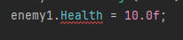
Access Modifiers
RPG Player Data
Private access modifier basically tells everyone else that this data is inaccessible and hidden.
So you can’t manipulate that data.

Slide 101
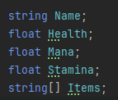
Access Modifiers
RPG Player Data
Private is the default access modifier.
So if you don’t specify any access modifier, it will always be private by default.

Slide 102
Access Modifiers
RPG Player Data
There are multiple access modifiers, such as:
private
private protected
protected
protected internal
internal
public
WE ARE ONLY INTERESTED IN 3.
Private and Public.
Protected which we will learn about later.

Slide 103
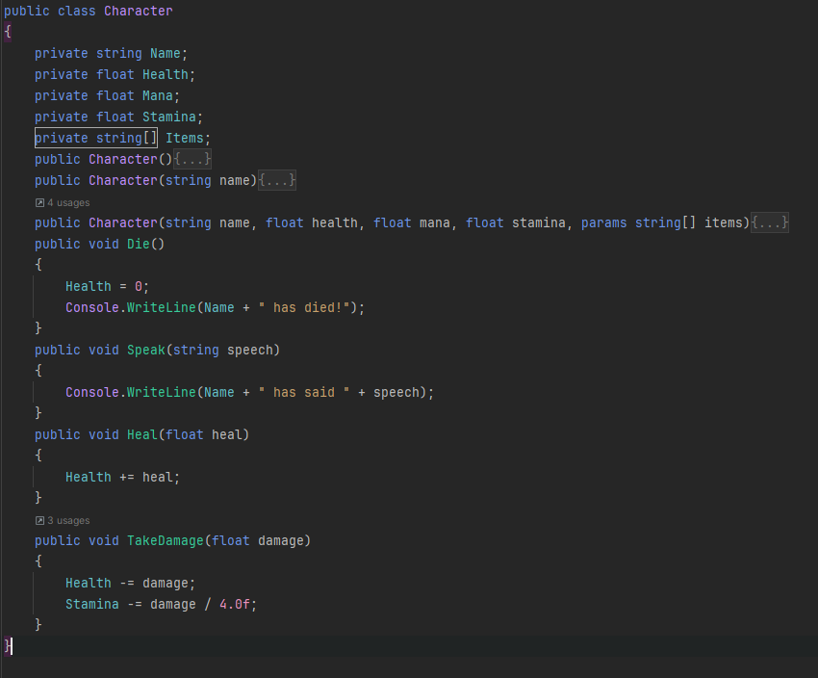
Access Modifiers
RPG Player Data
As a rule of thumb.
Variables should ALWAYS be private.
Methods should Mostly be public.

Slide 104
Access Modifiers
RPG Player Data
Sometimes we might have extra methods that the user shouldn’t care about

Slide 105
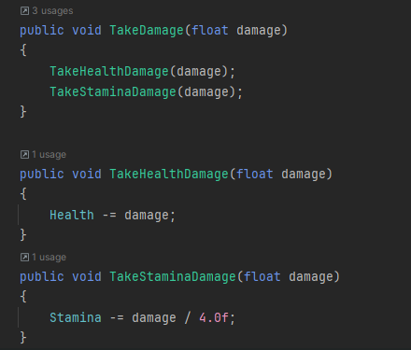
Access Modifiers
RPG Player Data
For example, we can split take damage into 2 parts, take health damage and take mana damage.

Slide 106
Access Modifiers
RPG Player Data
This helps us split our functionalities and make our code simpler. But in turn, it will grant others access to those methods.
Those methods are only there to clean up my method.
And not for external use.
You can’t just take stamina damage on it’s own.

Slide 107
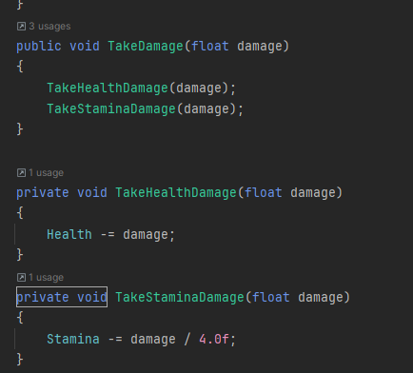
Access Modifiers
RPG Player Data
Now we have ensured that we can’t call those methods outside the class by accident.
They are the HOW of our method.
Methods should only represent the WHAT of the system.
Like what functionality does my class have.
Not how it implements them.

Slide 108
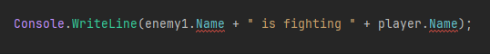
Access Modifiers
RPG Player Data
What if we need to read the name of one of our characters? For example, printing that 2 characters are fighting.

Slide 109
Access Modifiers
RPG Player Data
We would have to turn our variable public, but that would break encapsulation.

Slide 110
Properties
RPG Player Data
Properties

Slide 111
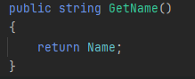
Access Modifiers
RPG Player Data
Remember, variables should never be public. Only in really rare cases which is mostly never.
But methods can be public!
We can define a method that asks the object WHAT is its name.

Slide 112
Access Modifiers
RPG Player Data
We can then use it freely without breaking encapsulation!
We are ensuring that our data is only handled according to set rules and logic of our own.

Slide 113
Access Modifiers
RPG Player Data
What we just defined is called a Getter.
It’s a method that simply returns a value of a variable.
We can add additional logic to return it in a special way if we would like, which is the main purpose. It handles the outside logic.

Slide 114
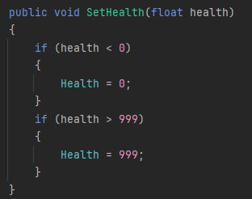
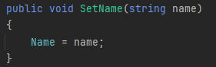
Access Modifiers
RPG Player Data
And to change a value of our class, we can also do something similar!
We can define a Setter.
We are free to add any sort of validation / logic to our getters and setters.

Slide 115
Access Modifiers
RPG Player Data
It might be tedious to define a getter and a setter for every variable.
And also their names can be long.
So in C# there is an easier way to define both getters and setters called a Property.

Slide 116
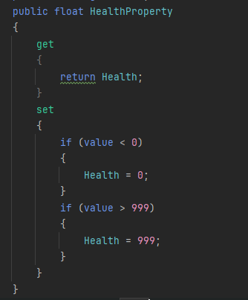
Access Modifiers
RPG Player Data
Properties are basically a hybrid between variables and methods.

Slide 117
Access Modifiers
RPG Player Data
They are defined exactly like a variable.
But they contain a body.

Slide 118

Access Modifiers
RPG Player Data
You can define 2 methods inside of them.
One of them is get.
To define a get you just write get keyword, open body and treat it as a getter.

Slide 119



Access Modifiers
RPG Player Data
Get can also have any access modifier other than public.
If it has no access modifier, it’s by default the same as access modifier of the property.
BUT you cant declare it as public.

Slide 120

Access Modifiers
RPG Player Data
The other method is set.
Set has a hidden parameter called value which is the input.

Slide 121

Access Modifiers
RPG Player Data
To use properties, you simply use them just as variables.

Slide 122

Access Modifiers
RPG Player Data
By default, any public member
should be Capitalized (CamelCase)
Meanwhile private members should be snakeCase
(Only first letter is not capitalized, everyfirst letter of every word after is capitalized)
This helps differentiate between public and private members.

